Slide 1

Optimization of Relational Algebra Expressions
Database Management System | Relational Model and Formal Query Languages
Course: Database Management System (DBMS) | Chapter: Relational Model and Formal Query Languages | Program: Bachelor of Engineering
DISCOVER · LEARN · EMPOWER
Notes:
Welcome everyone to today's session on optimizing relational algebra expressions. This topic is crucial for understanding how databases execute queries efficiently. We will move from theoretical concepts to practical optimization techniques used in real-world systems.

Slide 2
Course Outcomes
SLIDE 2 / 14
Course Outcome
CO | BT LEVEL | DESCRIPTION
CO1 | BT2 | Explain database architecture, relational model concepts and formal query language foundations including relational algebra and relational calculus.
CO2 | BT3 | Apply relational algebra, relational calculus and SQL constructs to formulate correct and efficient database queries.
CO3 | BT4 | Analyze functional dependencies and design normalized relational schemas up to 5NF ensuring lossless join and dependency preservation.
CO4 | BT4 | Analyze transaction schedules and concurrency control mechanisms to determine serializability, recoverability and correctness.
CO5 | BT5 | Evaluate storage structures, indexing strategies and query optimization techniques for performance, scalability and reliability.
Chandigarh University
2 / 14
Notes:
Today's lecture directly addresses CO2 by teaching you how to formulate efficient queries through algebraic optimization. While CO3 focuses on schema design, efficient query execution relies on the optimized algebraic expressions we will study. Mastering this ensures your database applications perform well under load.

Slide 3
Learning Objectives
SLIDE 3 / 14
Learning Outcomes
1
Define the core concept of query optimization in relational databases.
2
Analyze the cost models used to estimate execution time for operations.
3
Apply heuristic rules to transform inefficient relational algebra expressions.
4
Evaluate the impact of join ordering on overall query performance.
5
Compare the trade-offs between different optimization strategies for complex queries.
Chandigarh University
3 / 14
Notes:
By the end of this lecture, you will be able to define query optimization and analyze cost models. You will learn to apply heuristic rules to transform inefficient expressions into efficient ones. We will also evaluate how join ordering impacts performance and compare different optimization strategies.

Slide 4
Lecture
SLIDE 4 / 14
What is Query Optimization?
1
Query optimization is the process of selecting the most efficient execution plan.
2
It transforms a logical query into a physical execution strategy with minimal cost.
3
The optimizer chooses the best join order, access method, and algorithm.
4
Without optimization, a query might take hours instead of milliseconds to run.
5
The goal is to minimize resource usage like CPU time and disk I/O.
Chandigarh University
4 / 14
Notes:
Query optimization is essentially the art of finding the fastest way to get your data. Think of it like a GPS navigation system that finds the shortest route to avoid traffic. Without it, a simple query might scan millions of rows unnecessarily, wasting valuable system resources.

Slide 5
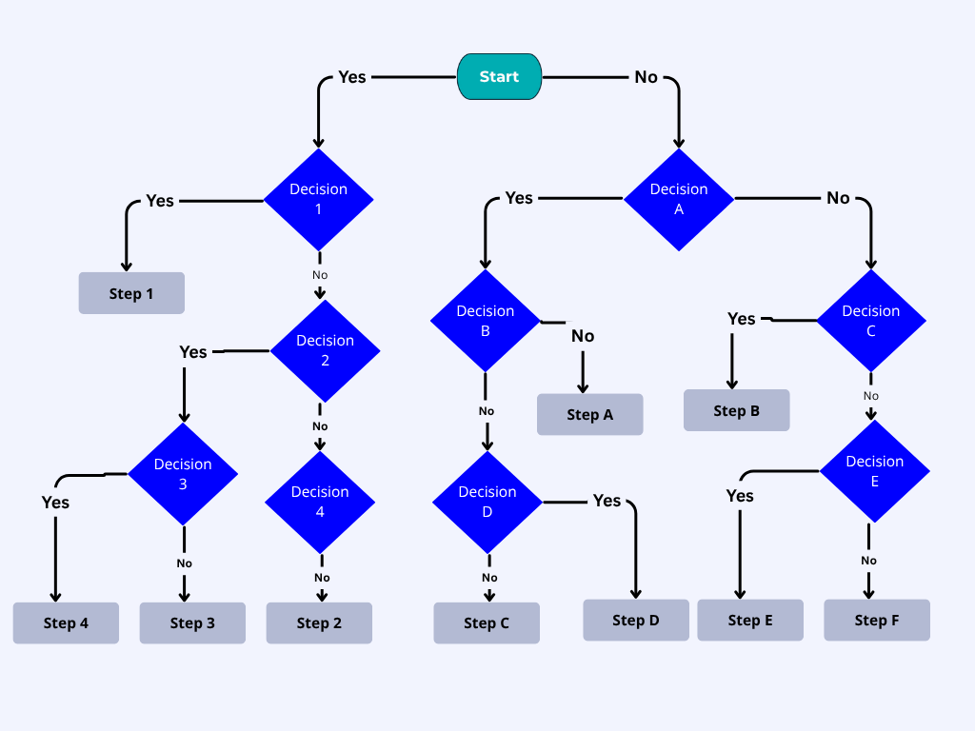
Lecture
SLIDE 5 / 14
Cost-Based vs Heuristic Optimization
1
Heuristic optimization uses rule-based transformations to improve query structure.
2
Cost-based optimization uses statistical data to estimate the cost of plans.
3
Heuristics are fast but may not find the absolute best plan available.
4
Cost-based methods are slower to compute but often yield better results.
5
Modern DBMS typically combine both approaches for optimal performance outcomes.
Source: www.invensislearning.com
Chandigarh University
5 / 14
Notes:
We have two main approaches: heuristic and cost-based optimization. Heuristics use fixed rules like pushing selections down, while cost-based methods calculate the estimated cost using statistics. Modern databases usually combine both to ensure we get the best performance without excessive computation time.

Slide 6
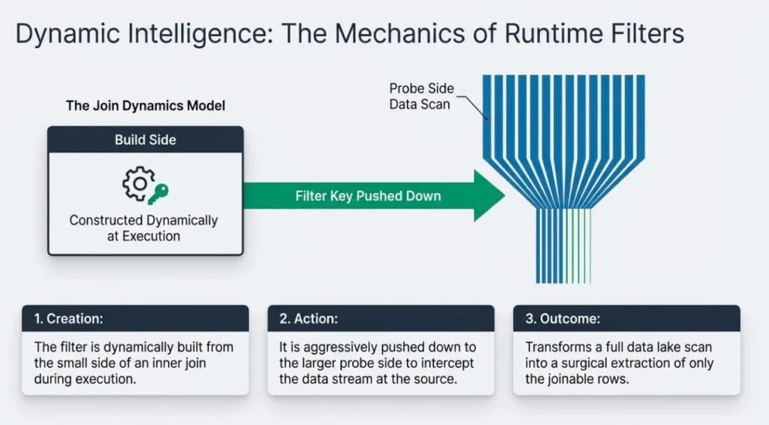
Lecture
SLIDE 6 / 14
Selection Pushdown Rule
EXAMPLE
Selecting students with GPA > 3.5 before joining with courses.
• Selection operations should be pushed as close to the data source as possible.
• Filtering rows early reduces the number of tuples processed by subsequent operations.
• This rule significantly reduces the intermediate result set size during execution.
• Applying this rule can reduce processing time by orders of magnitude.
Source: each3chdfq8.exactdn.com
Chandigarh University
6 / 14
Notes:
The selection pushdown rule is fundamental to optimization. By filtering data early, we reduce the number of rows that need to be processed by subsequent operations like joins. For example, if you filter students with a high GPA before joining with courses, you process far fewer rows.

Slide 7
Lecture
SLIDE 7 / 14
Projection Pushdown Rule
1
Projection operations should be pushed down to reduce attribute count early.
2
Selecting only required columns reduces memory usage and I/O requirements.
3
This rule prevents unnecessary data transfer between different processing stages.
4
It is particularly effective when the join condition involves few attributes.
5
Applying projection early minimizes the size of intermediate result sets.
Chandigarh University
7 / 14
Notes:
Similar to selection, projection pushdown reduces the amount of data we need to handle. By selecting only the necessary columns early, we reduce memory usage and I/O requirements. This is especially effective when the join condition involves only a few attributes, saving significant processing time.

Slide 8
Lecture
SLIDE 8 / 14
Join Ordering Optimization
1
The order in which relations are joined affects the total execution cost.
2
Joining smaller intermediate results first often leads to better performance.
3
A naive left-to-right join order may not be the most efficient.
4
The optimizer evaluates different join sequences to find the minimum cost.
5
Incorrect join ordering can lead to exponential growth in intermediate results.
Chandigarh University
8 / 14
Notes:
Join ordering is critical because the order in which you combine tables drastically affects performance. Joining smaller intermediate results first often leads to better performance than a naive left-to-right approach. An incorrect join ordering can lead to exponential growth in intermediate results, making the query extremely slow.

Slide 9
Worked Example
SLIDE 9 / 14
Join Cost Calculation
GOVERNING EQUATION
Cost of nested loop join = |A| × |B| = 1000 × 500 = 500,000 I/Os
1
Consider joining Table A (1000 tuples) with Table B (500 tuples).
2
Cost of hash join = |A| + |B| + overhead ≈ 1500 + overhead I/Os.
3
If Table A is filtered to 100 tuples first, cost drops to 50,000 I/Os.
4
Optimization reduces the cost from 500,000 to 50,000 I/O operations.
Chandigarh University
9 / 14
Notes:
Let's look at a numerical example. Joining 1000 tuples with 500 tuples using a nested loop requires 500,000 I/O operations. However, if we filter Table A to 100 tuples first, the cost drops to just 50,000 I/Os. This demonstrates how a simple optimization can reduce the cost by a factor of ten.

Slide 10

Lecture
SLIDE 10 / 14
Common Pitfalls in Optimization
1
Ignoring statistics can lead to suboptimal join order selection.
2
Over-optimizing for one query may degrade performance for others.
3
Assuming uniform data distribution often leads to inaccurate cost estimates.
4
Neglecting index usage can result in full table scans unnecessarily.
5
Complex queries may require manual hints when the optimizer fails.
Source: static.vecteezy.com
Chandigarh University
10 / 14
Notes:
There are several common pitfalls to avoid. Ignoring statistics can lead to suboptimal join order selection, while assuming uniform data distribution often leads to inaccurate cost estimates. Over-optimizing for one query may degrade performance for others, so we must balance our strategies carefully.

Slide 11
Lecture
SLIDE 11 / 14
Index Usage in Optimization
1
Indexes allow the optimizer to skip scanning irrelevant data blocks.
2
Using an index on a join column can drastically reduce join cost.
3
The optimizer chooses between index scan and full table scan based on cost.
4
Too many indexes can slow down write operations and maintenance tasks.
5
Selectivity determines whether an index is beneficial for a specific query.
Chandigarh University
11 / 14
Notes:
Indexes play a crucial role in optimization by allowing the system to skip scanning irrelevant data blocks. The optimizer chooses between an index scan and a full table scan based on the estimated cost. However, too many indexes can slow down write operations, so we must balance read and write performance.

Slide 12
Lecture
SLIDE 12 / 14
Equivalence of Algebraic Expressions
1
Different relational algebra expressions can produce the same result.
2
Optimization relies on finding equivalent expressions with lower execution cost.
3
Commutative and associative laws allow rearranging operations freely.
4
Selection and projection operations can often be reordered without changing results.
5
The optimizer searches the space of equivalent expressions for the best plan.
Chandigarh University
12 / 14
Notes:
Optimization relies on the fact that different relational algebra expressions can produce the same result. We use commutative and associative laws to rearrange operations freely. The optimizer searches the space of equivalent expressions to find the one with the lowest execution cost.

Slide 13
Lecture
SLIDE 13 / 14
Key Takeaways
1
Query optimization selects the most efficient execution plan for a given query.
2
Pushing selections and projections down reduces intermediate result set sizes.
3
Join ordering significantly impacts performance and must be carefully chosen.
4
Cost-based optimization uses statistics to estimate the cost of different plans.
5
Understanding these concepts is essential for designing efficient database applications.
Chandigarh University
13 / 14
Notes:
To summarize, query optimization selects the most efficient execution plan by pushing selections and projections down. Join ordering significantly impacts performance, and cost-based optimization uses statistics to estimate costs. Understanding these concepts is essential for designing efficient database applications that scale well.

Slide 14
Lecture
SLIDE 14 / 14
References
1
Fundamentals of Database Systems — Ramez Elmasri & Shamkant B. Navathe
2
Database System Concepts — Silberschatz, Korth & Sudarshan
3
Database Management Systems — Raghu Ramakrishnan & Johannes Gehrke
4
Oracle/MySQL Documentation — Oracle
Chandigarh University
14 / 14
Notes:
For further reading, I recommend the textbooks by Elmasri & Navathe, Silberschatz et al., and Ramakrishnan & Gehrke. These resources provide comprehensive coverage of relational algebra and optimization techniques. The Oracle and MySQL documentation also offers practical insights into real-world implementation details.

